Slide 1

Instagram User Analytics
Author – Vinayak Swami

Slide 2
Project Overview
This project aims to analyze the Instagram users. The entire analysis involves marketing analysis as well as investor metrics. The analysis will be done in MySQL workbench using SQL queries.

Slide 3
Database
The database consist of 7 tables that provide data related to the user engagement with the Instagram platform in terms of posting photos, liking posts and ads, following and followers of other users, tags used etc.

Slide 4
Project Approach

Slide 5

Step 1: Understanding Data
The database is created first and then the database is imported to MySQL workbench for analysis.
Users Table : This table have the 100 users who created their Instagram profiles in 2016 and 2017.
Tags table : Different tags with id, name & when it created.
Photos Table : Photos posted by users with id, image url, user id & created date.
Likes table : Likes with user id, photo id, created at
Follows table : followers & follows' with their id & created at
Comments table : Comment with comment id & when created
Photo tags table : photo id with added tags on photo

Slide 6
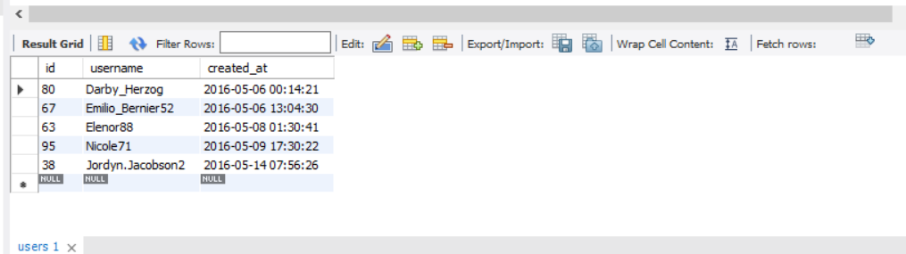
Step 2: Data Analysis & Driving Insights
Marketing Analysis
1. Loyal User reward : The marketing team wants to reward the most loyal users, i.e., those who have been using the platform for the longest time.
Task : Identify the five oldest users on Instagram from the provided database.
select * from users order by created_at limit 5;
Output:

Slide 7
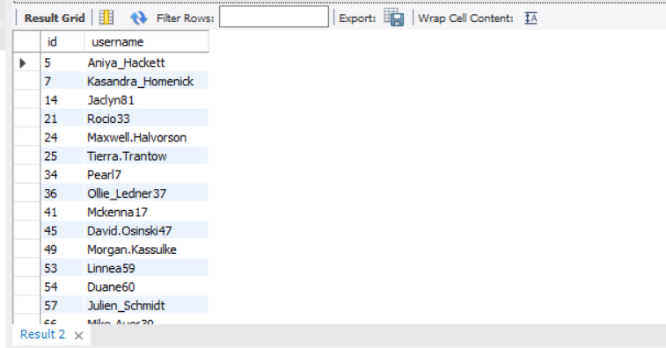
2.Inactive User Engagement: The team wants to encourage inactive users to start posting by sending them promotional emails.
Task : Identify users who have never posted a single photo on Instagram.
select u.id,u.username from users u left join photos p
on u.id=p.user_id where p.user_id is null;
Output:

Slide 8
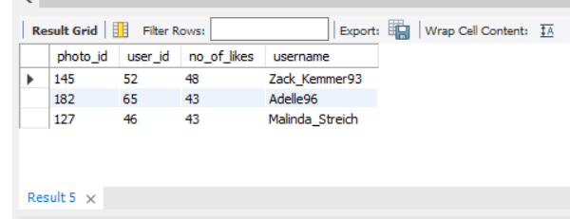
3. Contest Winner Declaration: The team has organized a contest where the user with the most likes on a single photo wins.
Task : Identify top 3 photos which got most no of likes.
with base as
(select count(user_id)as no_of_likes,photo_id from likes group by photo_id order by no_of_likes desc limit 3)
select b.photo_id, p.user_id,u.username from base b join photos p on b.photo_id= p.id join users u on p.user_id= u.id;
Output:

Slide 9
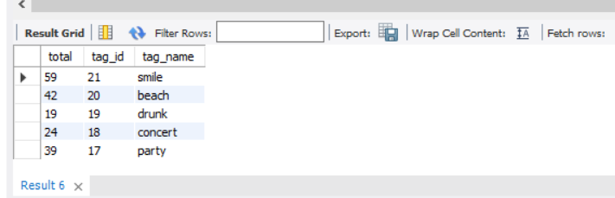
4. Hashtag Research: A partner brand wants to know the most popular hashtags to use in their posts to reach the most people.
Task : Identify and suggest the top 5 most commonly used hashtags on the platform.
select count(photo_id)as total, tag_id, tag_name from photo_tags p join tags t on p.tag_id=t.id group by tag_id order by tag_id desc limit 5 ;
Output:

Slide 10
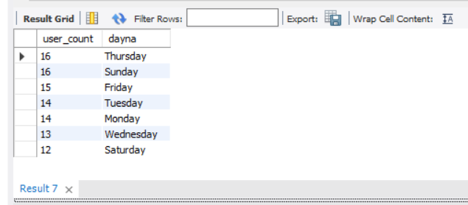
5. Ad Campaign Launch: The team wants to know the best day of the week to launch ads.
Task : What day of the week do most users register on? Provide insights on when to schedule an ad campaign.
select count(id)as user_count,dayname(created_at)as dayna from users group by dayna order by user_count desc ;
Output:
The analysis shows that Sunday and Thursday are the days on which maximum people register in Instagram.

Slide 11
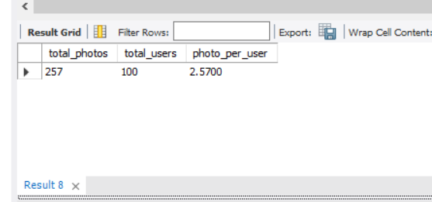
B) Investor Metrics:
1. User Engagement: Investors want to know if users are still active and posting on Instagram or if they are making fewer posts.
Task : Provide how many times does average user posts on Instagram. Also, provide the total number of photos on Instagram/total number of users
with base as
( select u.id as userid, count(p.id) as photoid from users u left join photos p on p.user_id=u.id group by u.id)
select sum(photoid) as total_photos,count(userid) as total_users, sum(photoid)/count(userid) as photo_per_user from base;
Output:

Slide 12
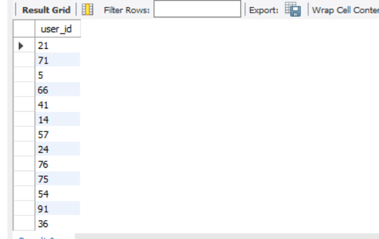
2. Bots & Fake Accounts: Investors want to know if the platform is crowded with fake and dummy accounts.
Task : Provide data on users (bots) who have liked every single photo on the site (since any normal user would not be able to do this).
with base as
( select u.id as userid, count(p.id) as photoid from users u left join photos p on p.user_id=u.id group by u.id)
select sum(photoid) as total_photos,count(userid) as total_users, sum(photoid)/count(userid) as photo_per_user from base;
Output:

Slide 13
Insights
In this project, it is identified that a lot of users who have created their profile in Instagram are still inactive which could be due to their lack of knowledge on “how to post photos or videos or reels”. So, such users should be sent tutorial emails to help them use the platform well and become active in it. It can also promote the ad clicks and thereby, businesses.
Through the context to identify user with maximum photo likes, more and more users are promoted to be more active in the platform.
Through most popular hashtags identification, the businesses who want to launch ads can use these hashtags for obtaining maximum reach and engagement for their ads.
As any social media platform will have fake profiles created, Instagram will also have fake accounts or profiles. It is extremely important to identify them. In this project, 13 fake accounts were detected.

Slide 14

Results
Through this project, I could identify 5 most used hashtags by the users in Instagram. On informing about these hashtags to the business profiles, they can use them in their ads which intends to increase the ad clicks and engagements which in turn increase the business at least by 50%. This is very significant in increasing Instagram platform’s influence in the public as well as its revenue.
Remove bots & fake accounts. Take strong action against who creates bots & fake accounts.
Use more Hashtags for brand promotions.
Collaborate with most active & most followed users.

Slide 15

Thank you
Vinayak Swami
vinayakswami64@gmail.com

